Slide 1


Slide 1
DATA DRIVEN
Project 1 Team-1

Slide 2
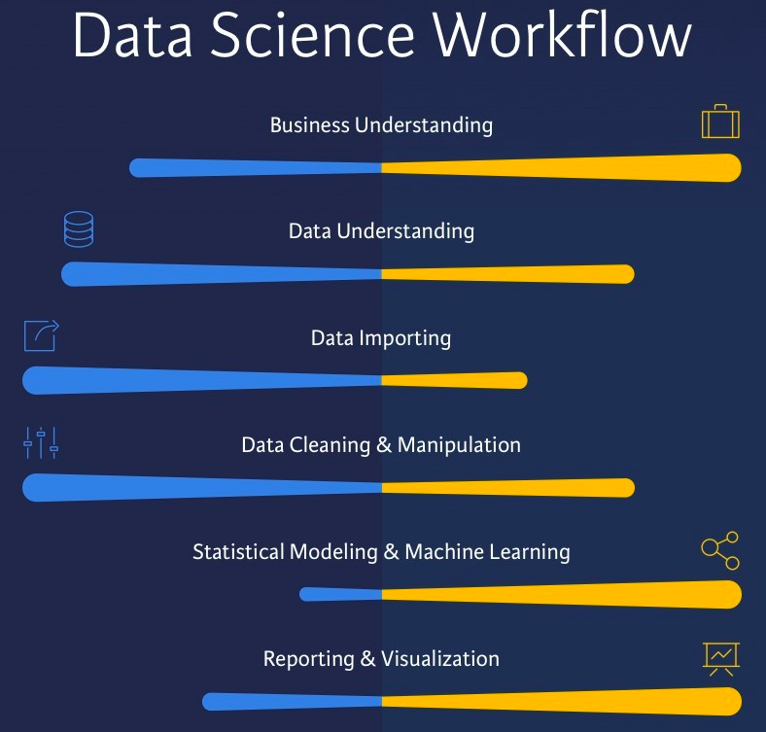
Slide 9
Project Process
Members:
Alice
Juhlian
Nick
Tifare
Mike
1

Slide 3

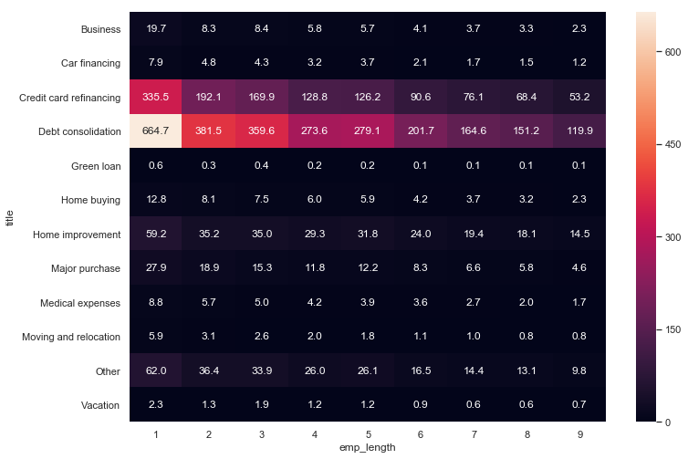
Slide 10
Loan Type related to Employment Tenure
Heat map illustrating Employment tenure related to loan type
2

Slide 4
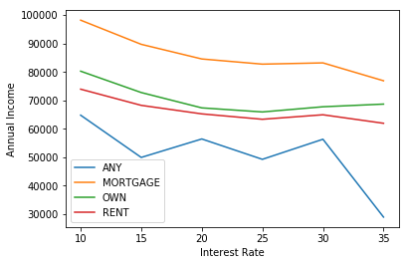
Slide 10
Annual Income by home type
Lending Club offers fixed rate loans to those who qualify
The data shows that those who have a mortgage tend to have a higher income with a lower interest rate
And those who Rent tend to have a lower income with a higher interest rate
3

Slide 5
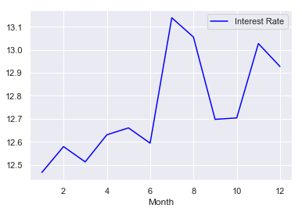
Slide 10
Loan Rates by Month (2018)
Analyzed Interest rates over time Line chart using pivot table
Illustrates how Loan interest rates peak in July/Aug and again during the holiday period
4

Slide 6
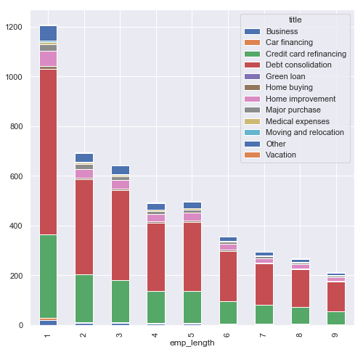
Slide 10
Employment Data and Loan Type
Bar Chart using cross tab data
5

Slide 7
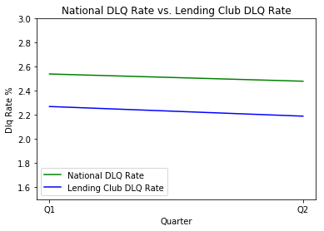
Slide 10
National Delinquency Rate vs Lending Club
The analysis of Lending Club’s delinquency rate displayed the lending club performed better than the national average for The first two quarters of 2018
The data from Q3 and Q4 were excluded from the graph as the age of the population did not allow enough time to show the true behavior of the population.
6

Slide 8
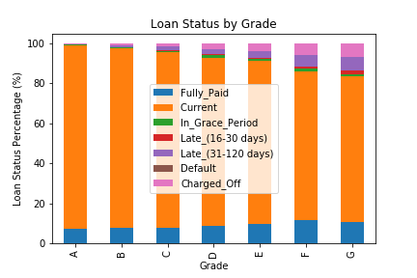
Slide 10
Loan Status By Grade
Analysis of the customer’s lending grade to loan outcome shows that customers with higher grades display better loan repayment performance.
7

Slide 9
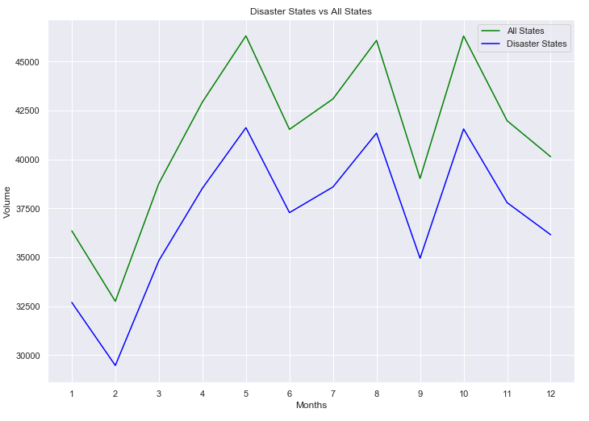
Slide 10
Disaster States
Compared to
All States
No difference in behavior from disaster states vs the population
Correlation: 0.9998459
8

Slide 10
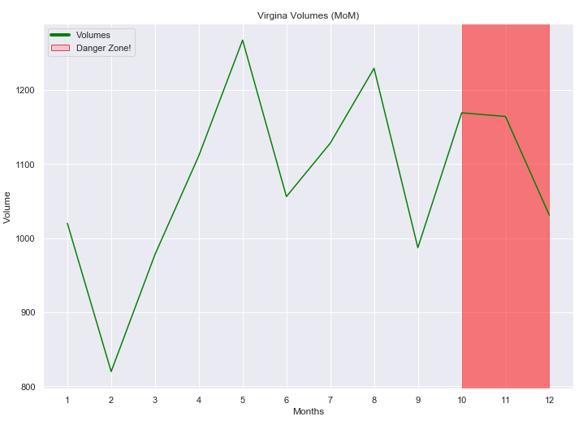
Slide 10
Disaster Volumes
For Virginia
Analysis proved were was no statistically significant impact of natural disasters on volume.
VA p-value=0.9860106088091637
9

Slide 11
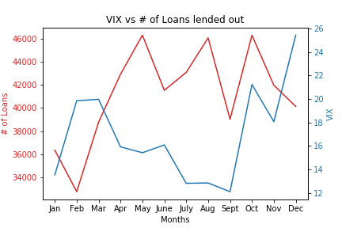
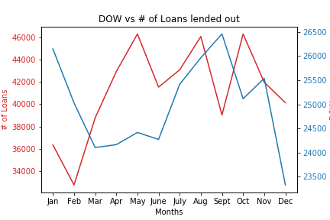
Slide 10
Loan Volume vs
DOW and VIX
10

Slide 12
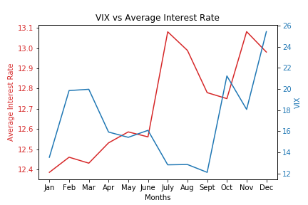
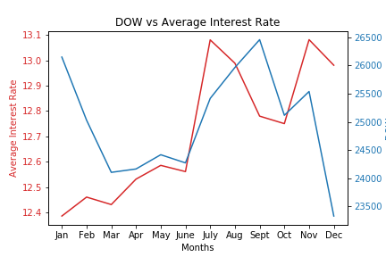
Slide 10
Average Loan Rates Vs.
DOW and VIX
11

Slide 13
Conclusion
Debt Consolidation loans were the largest type of loans
Interest Rates spiked in the summer and again towards the holidays
There very little correlation between the stock market and the loan data
Natural disasters were not correlated to the loan data in terms of amount or timing
Demographic data such as employment tenure and income were correlated to the loan type and amount
People with high loan grade evaluations had less delinquency

